Slide 1
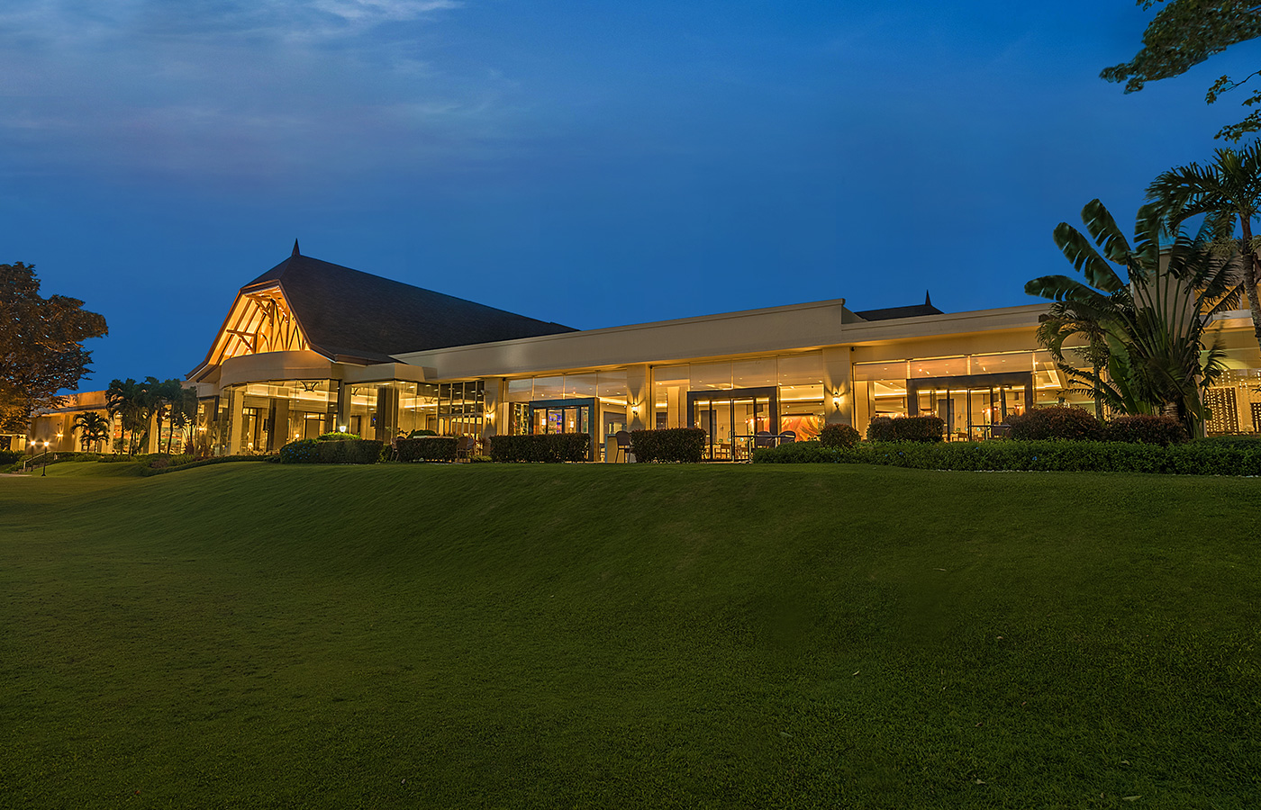
Hotel Service Request and Report System
Furuya | Chavez | Meer | Peralta | Bonifacio | Borlongan

Slide 2





Introduction
Project Context, Statement of the Objectives,
Scope and Limitations of the study
Review of Related Systems
Hotel Service Request and Report System
Foreign
Technical Background
Programming Language
Hardware Requirements
Software Requirements
The Existing System
Company Background
Description of the System
Problem Areas
Proposed System Diagrams
Context Dioagram | Data Flow Diagram | ERD | Use Case Diagram | Activity Diagram | Sequence Diagram

Slide 3
Introduction
Project Context, Statement of the Objectives,
Scope and Limitations of the study
Review of Related Systems
Hotel Service Request and Report System
Foreign
Technical Background
Programming Language
Hardware Requirements
Software Requirements
The Existing System
Company Background
Description of the System
Problem Areas
Proposed System Diagrams
Context Dioagram | Data Flow Diagram | ERD | Use Case Diagram | Activity Diagram | Sequence Diagram

Slide 4

Client: Taal Vista Hotel
Hotel Industry have the biggest energy users in carrying out its services
One of the challenges in service management is on how the hotel cater requests.
The Taal Vista hotel uses a smart tool called “Freshdesk” but they are still manually creating the summary report of its services
PROJECT CONTEXT

Slide 5
General Objective
To improve the Hotel Service Request of Taal Vista Hotel through user interface and a reliable automated system.

Slide 6
Specific Objectives
To develop a fully automated system that will record all guest’s service request.
To generate a summary report of all the service request in a daily basis, that will help the management identify the usual problems they experience.
To have a real time monitoring of the service request made by the guest

Slide 7

Only housekeeping and engineering departments will receive the real time record of the requested tickets.
The system can provide each department’s report and the entire tickets managed by the hotel.
Reports can be generated in a daily, weekly, monthly basis.
SCOPE

Slide 8

LIMITATIONS
Escalation process of the tickets will not be the scope of the system but once the ticket is generated, a time threshold will start and will only be stopped once the request is already accomplished.
Reports made by the system cannot directly create a conclusion.

Slide 9
Introduction
Project Context, Statement of the Objectives,
Scope and Limitations of the study
Review of Related Systems
Hotel Service Request and Report System
Foreign
Technical Background
Programming Language
Hardware Requirements
Software Requirements
The Existing System
Company Background
Description of the System
Problem Areas
Proposed System Diagrams
Context Dioagram | Data Flow Diagram | ERD | Use Case Diagram | Activity Diagram | Sequence Diagram

Slide 10

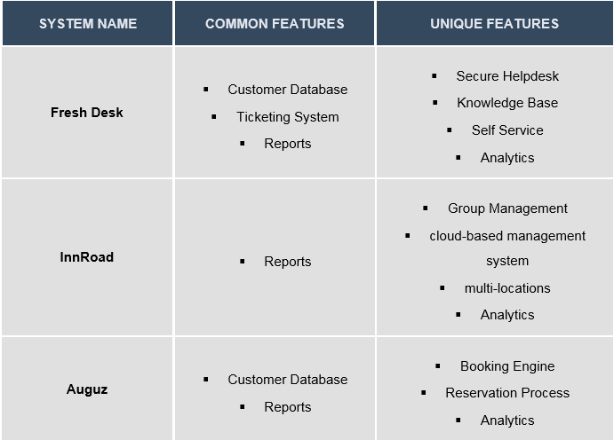
Review of Related Softwares

Slide 11
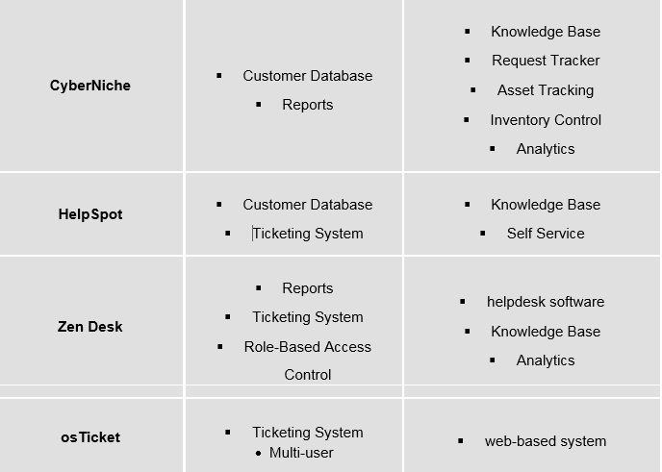
Review of Related Softwares

Slide 12
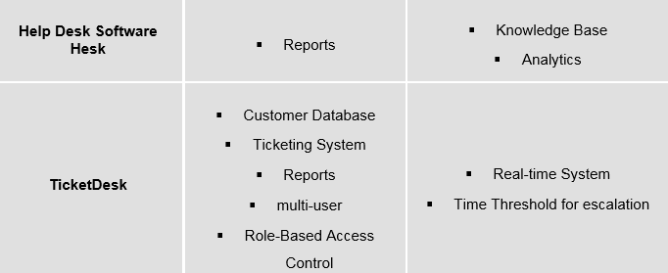
Review of Related Softwares

Slide 13
Introduction
Project Context, Statement of the Objectives,
Scope and Limitations of the study
Review of Related Systems
Hotel Service Request and Report System
Foreign
Technical Background
Programming Language
Hardware Requirements
Software Requirements
The Existing System
Company Background
Description of the System
Problem Areas
Proposed System Diagrams
Context Dioagram | Data Flow Diagram | ERD | Use Case Diagram | Activity Diagram | Sequence Diagram

Slide 14

Programming Language | Hardware Requirements | Software Requirements
PHP (Hypertext Preprocessor) | Server | Yii Framework
SQL ( Structured Query language) | Computer | Jasper Reports
 | Mobile Devices
 | Network

Slide 15
Introduction
Project Context, Statement of the Objectives,
Scope and Limitations of the study
Review of Related Systems
Hotel Service Request and Report System
Foreign
Technical Background
Programming Language
Hardware Requirements
Software Requirements
The Existing System
Company Background
Description of the System
Problem Areas
Proposed System Diagrams
Context Dioagram | Data Flow Diagram | ERD | Use Case Diagram | Activity Diagram | Sequence Diagram

Slide 17
Introduction
Project Context, Statement of the Objectives,
Scope and Limitations of the study
Review of Related Systems
Hotel Service Request and Report System
Foreign
Technical Background
Programming Language
Hardware Requirements
Software Requirements
The Existing System
Company Background
Description of the System
Problem Areas
Proposed System Diagrams
Context Dioagram | Data Flow Diagram | ERD | Use Case Diagram | Activity Diagram | Sequence Diagram

Slide 18
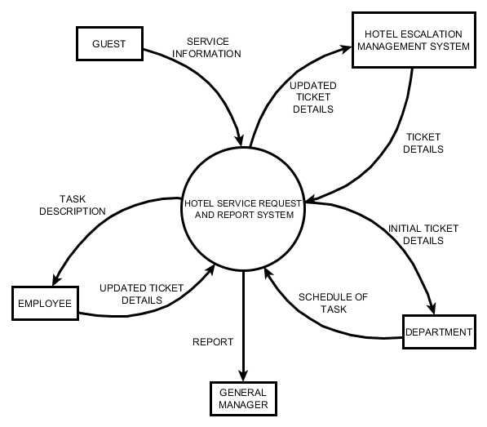
Context Diagram

Slide 19
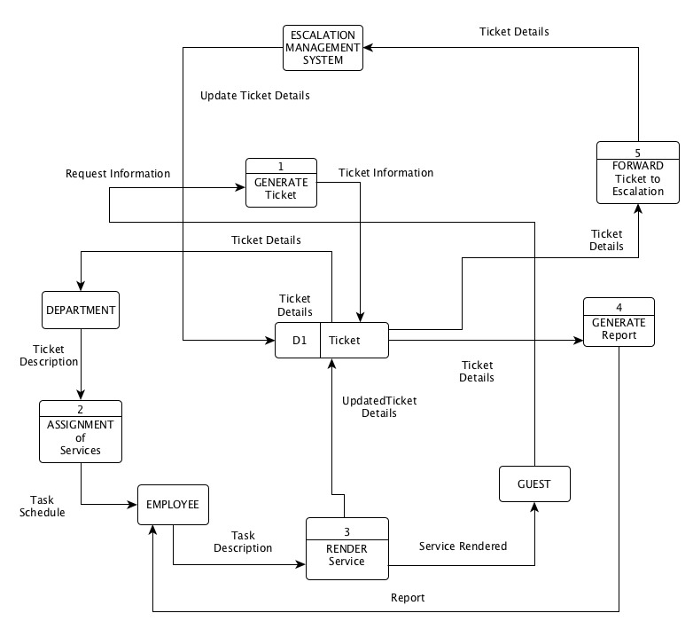
Data Flow Diagram

Slide 20
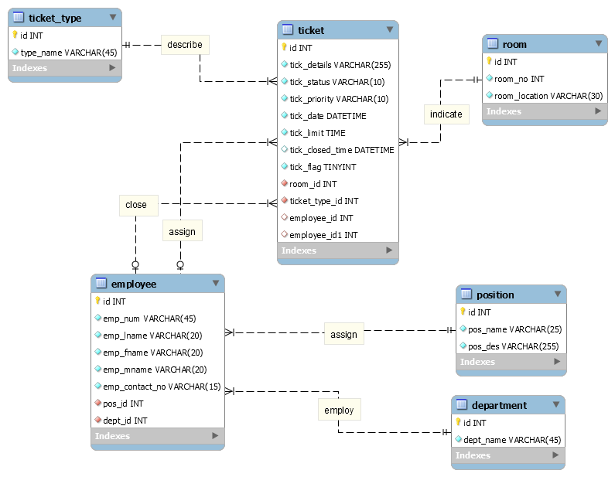
Entity Relationship Diagram

Slide 21
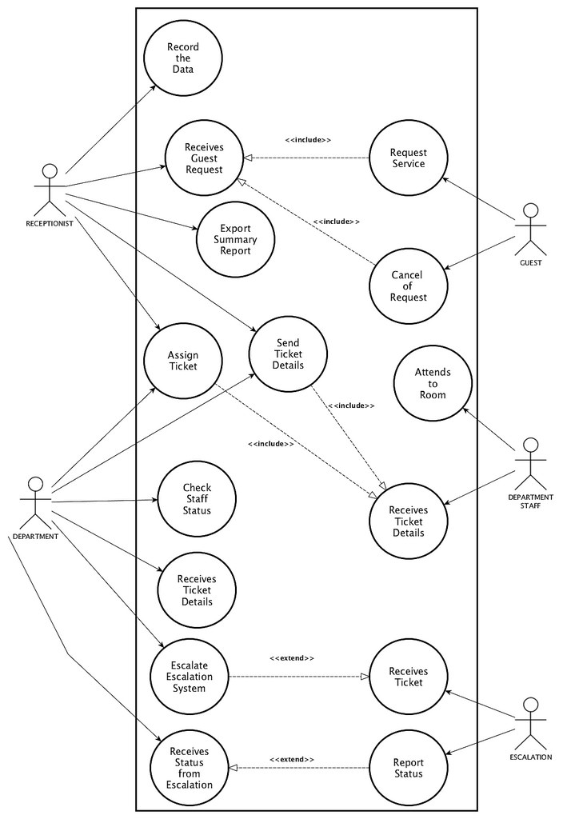
Use Case Diagram

Slide 22
Activity Diagram (Redirection of Service)

Slide 23
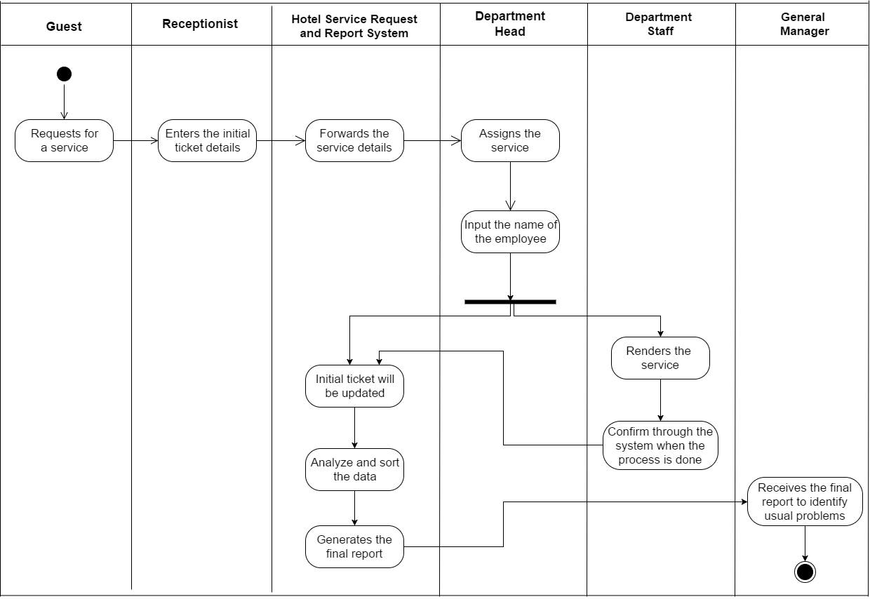
Activity Diagram (Generation of Report)

Slide 24
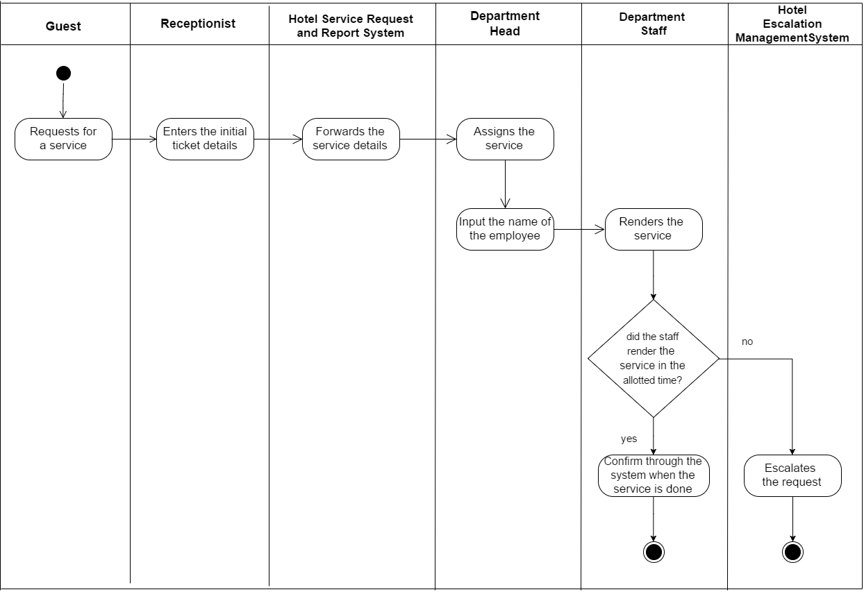
Activity Diagram (To Escalation)

Slide 25
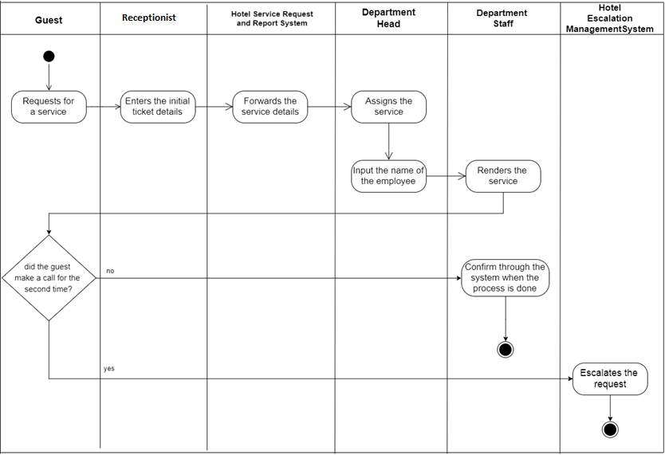
Activity Diagram (To Escalation v2)

Slide 26
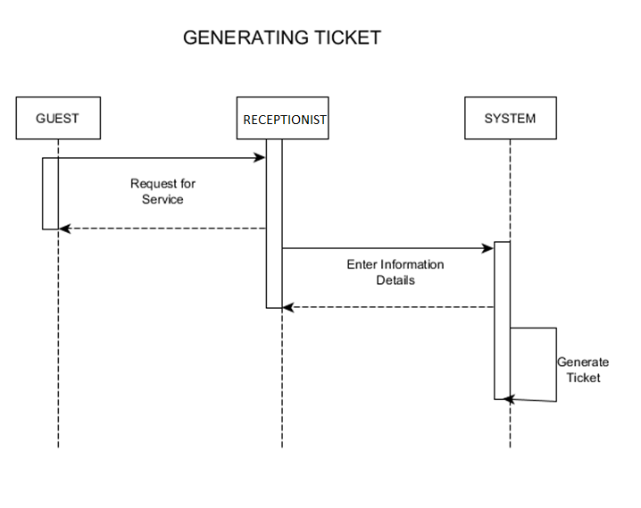
Sequence Diagram

Slide 27
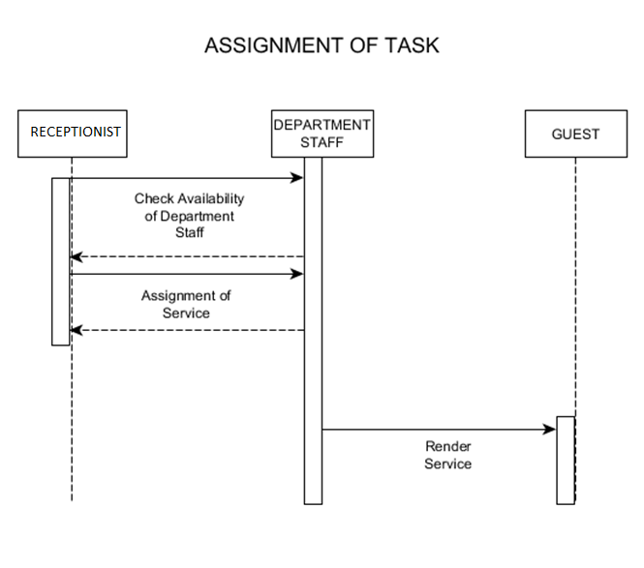
Sequence Diagram

Slide 28
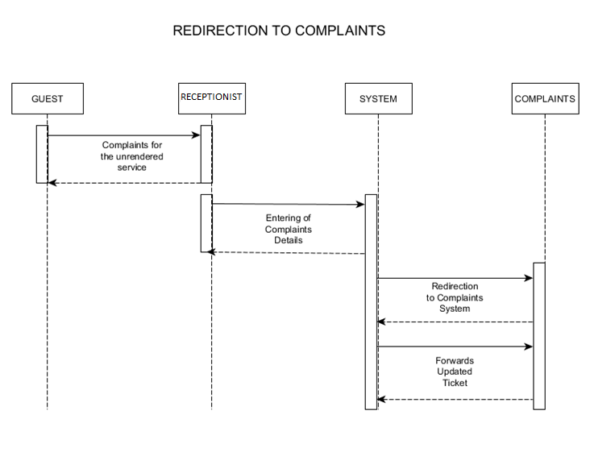
Sequence Diagram

Slide 29
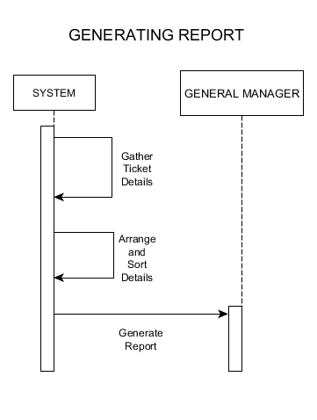
Sequence Diagram

